Slide 1
Deep learning trics
Ho-min Park
+82-10-4731-3162
homin.park@ghent.ac.kr
powersimmani@gmail.com
https://github.com/powersimmani

Slide 2
MLP – 모든 함수 근사 가능
Machine learning / Supervised learning unsupervised learning….
입출력만 정의하기 나름이지 다 함수임

Slide 3
Dropout

Slide 4
Skip connection

Slide 5
Curse of dimension

Slide 6
Feature selection

Slide 7
Feature selection

Slide 8
Feature extraction – dimensional
Dimensional reduction

Slide 9
Feature extraction – dimsnioanl
두가지로 쓸 수 있지
시각화할때도 쓰고 실제 축소해서도 쓰고

Slide 10
Feature extraction
Encoder decoder model

Slide 11
Image modality

Slide 12
Image modality cnn

Slide 13
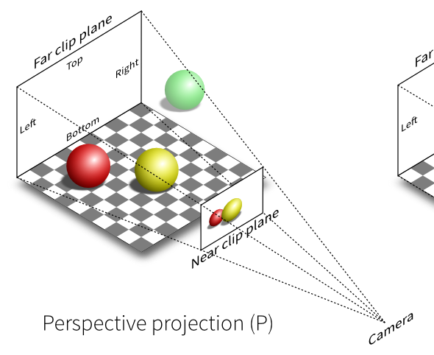
Image
A visual representation drawn on a two-dimensional plane
Digital image (image)
A file that digital form of pictures and drawings.
Obtained by photographing objects in the real world or using a scanner.
Stored in digital devices such as computers, mobile phones, etc.
With the development of photography, storage and sharing technology, it occupies a large part of modern data.
How can we represent an image using bits?
https://www.reduser.net/forum/showthread.php?163407
-VistaVision-and-Monstro-and-cinematography/page9

Slide 14

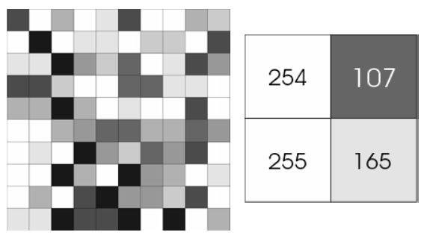

1 byte $→$ 1 grey pixel = 2 hexadecimal
Pixel: a basic unit constituting a digital image
The light intensity is expressed as a value between 0 and 255 (uint8)
https://www.researchgate.net/figure/
Figure-216-A-8-bit-grayscale-image-pixel-value-ranges-between-0-black_fig14_328828460

Slide 15
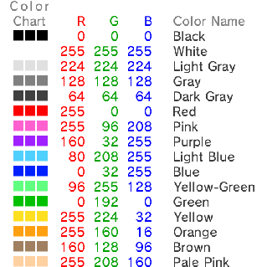
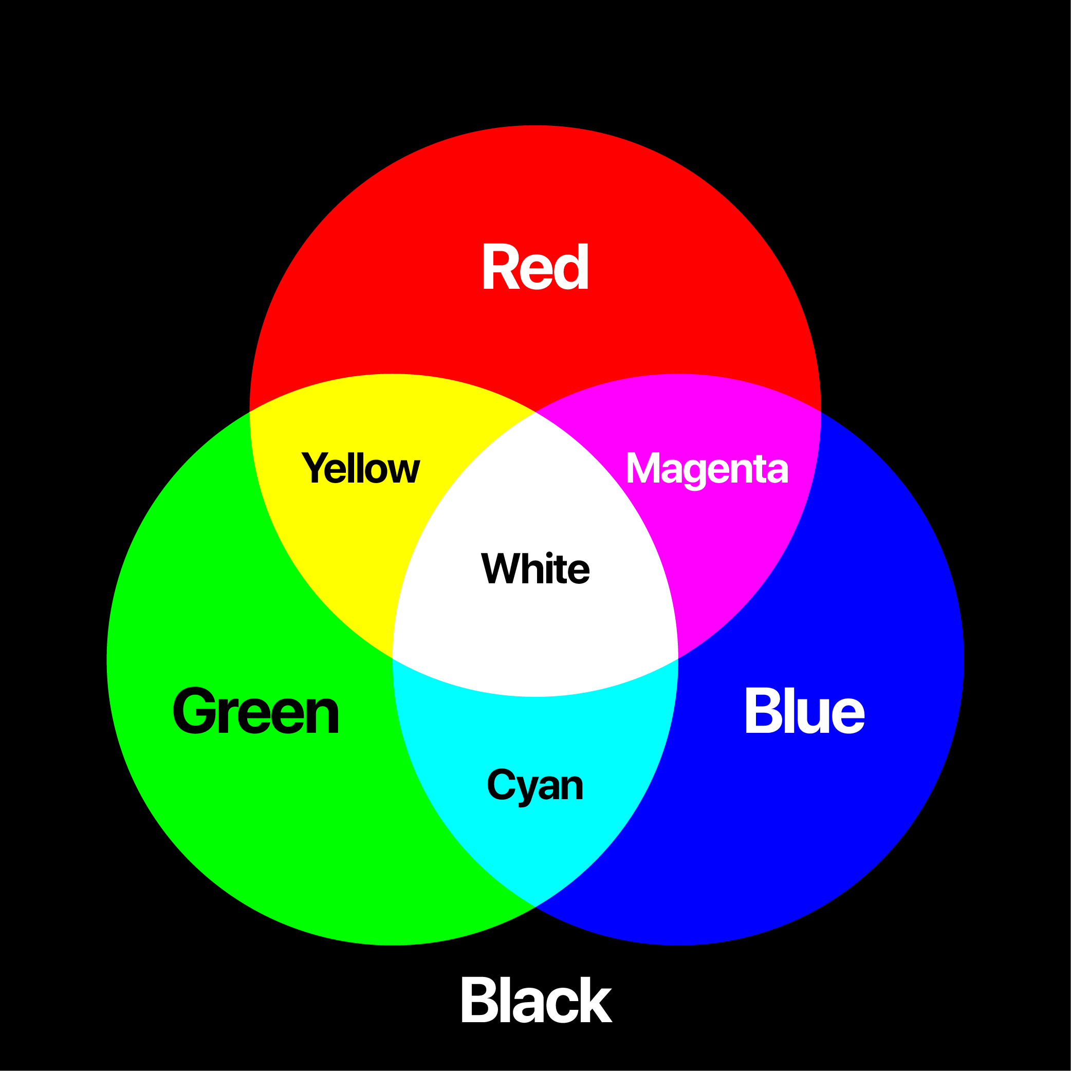

3 bytes $→$ 1 color pixel = 6 hexadecimal
Consists of three primary colors of light: red, green, and blue
Each R, G and B is called a channel.
One channel can have a value from 0 to 255.
A total of 16,777,216 colors can be expressed

Slide 16

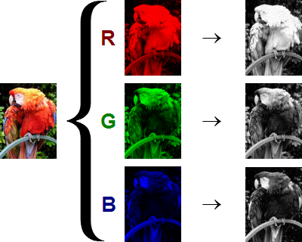
3 channels of RGB
If the size of a color image is 300 * 600, the image has (3 * 300 * 600) bytes.
If the size of a grey image is 300 * 600, the image has (300 * 600) bytes.

Slide 17
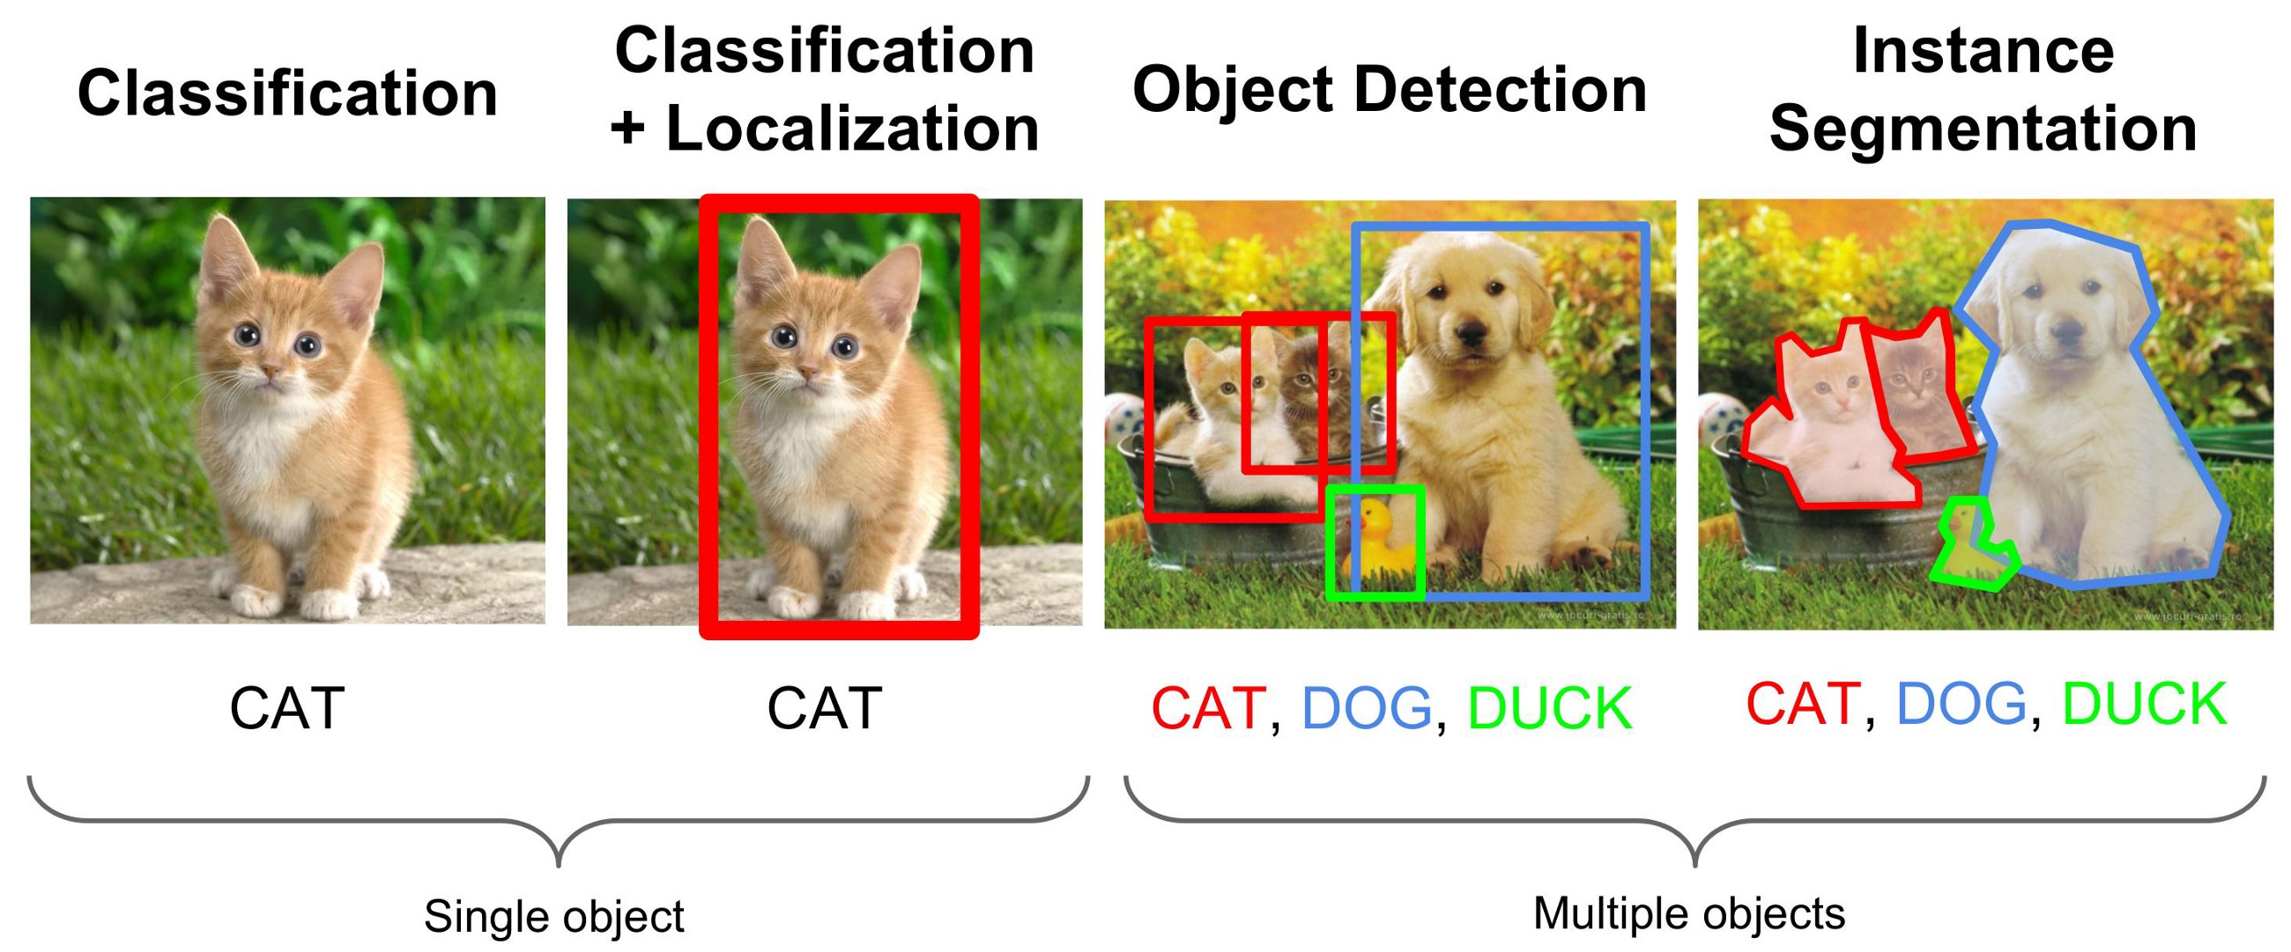
Major tasks of deep learning on image

Slide 18

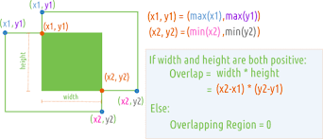
Deep learning on image – specific outputs
Cat: 70%
Dog: 20%
Duck: 10%

Slide 19
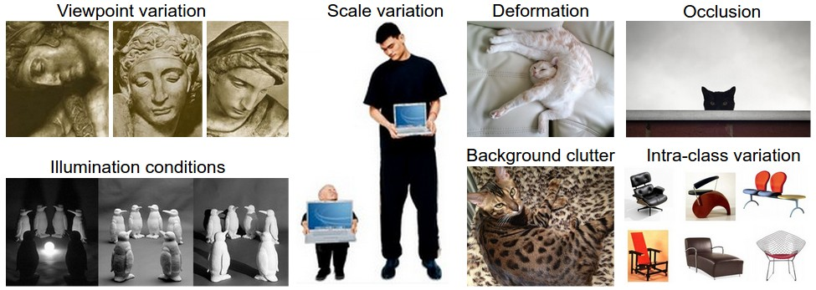
Difficulties in image artificial intelligence
http://cs231n.github.io/classification/

Slide 20
Image modality
문제점과 양 르쿤 모델

Slide 21
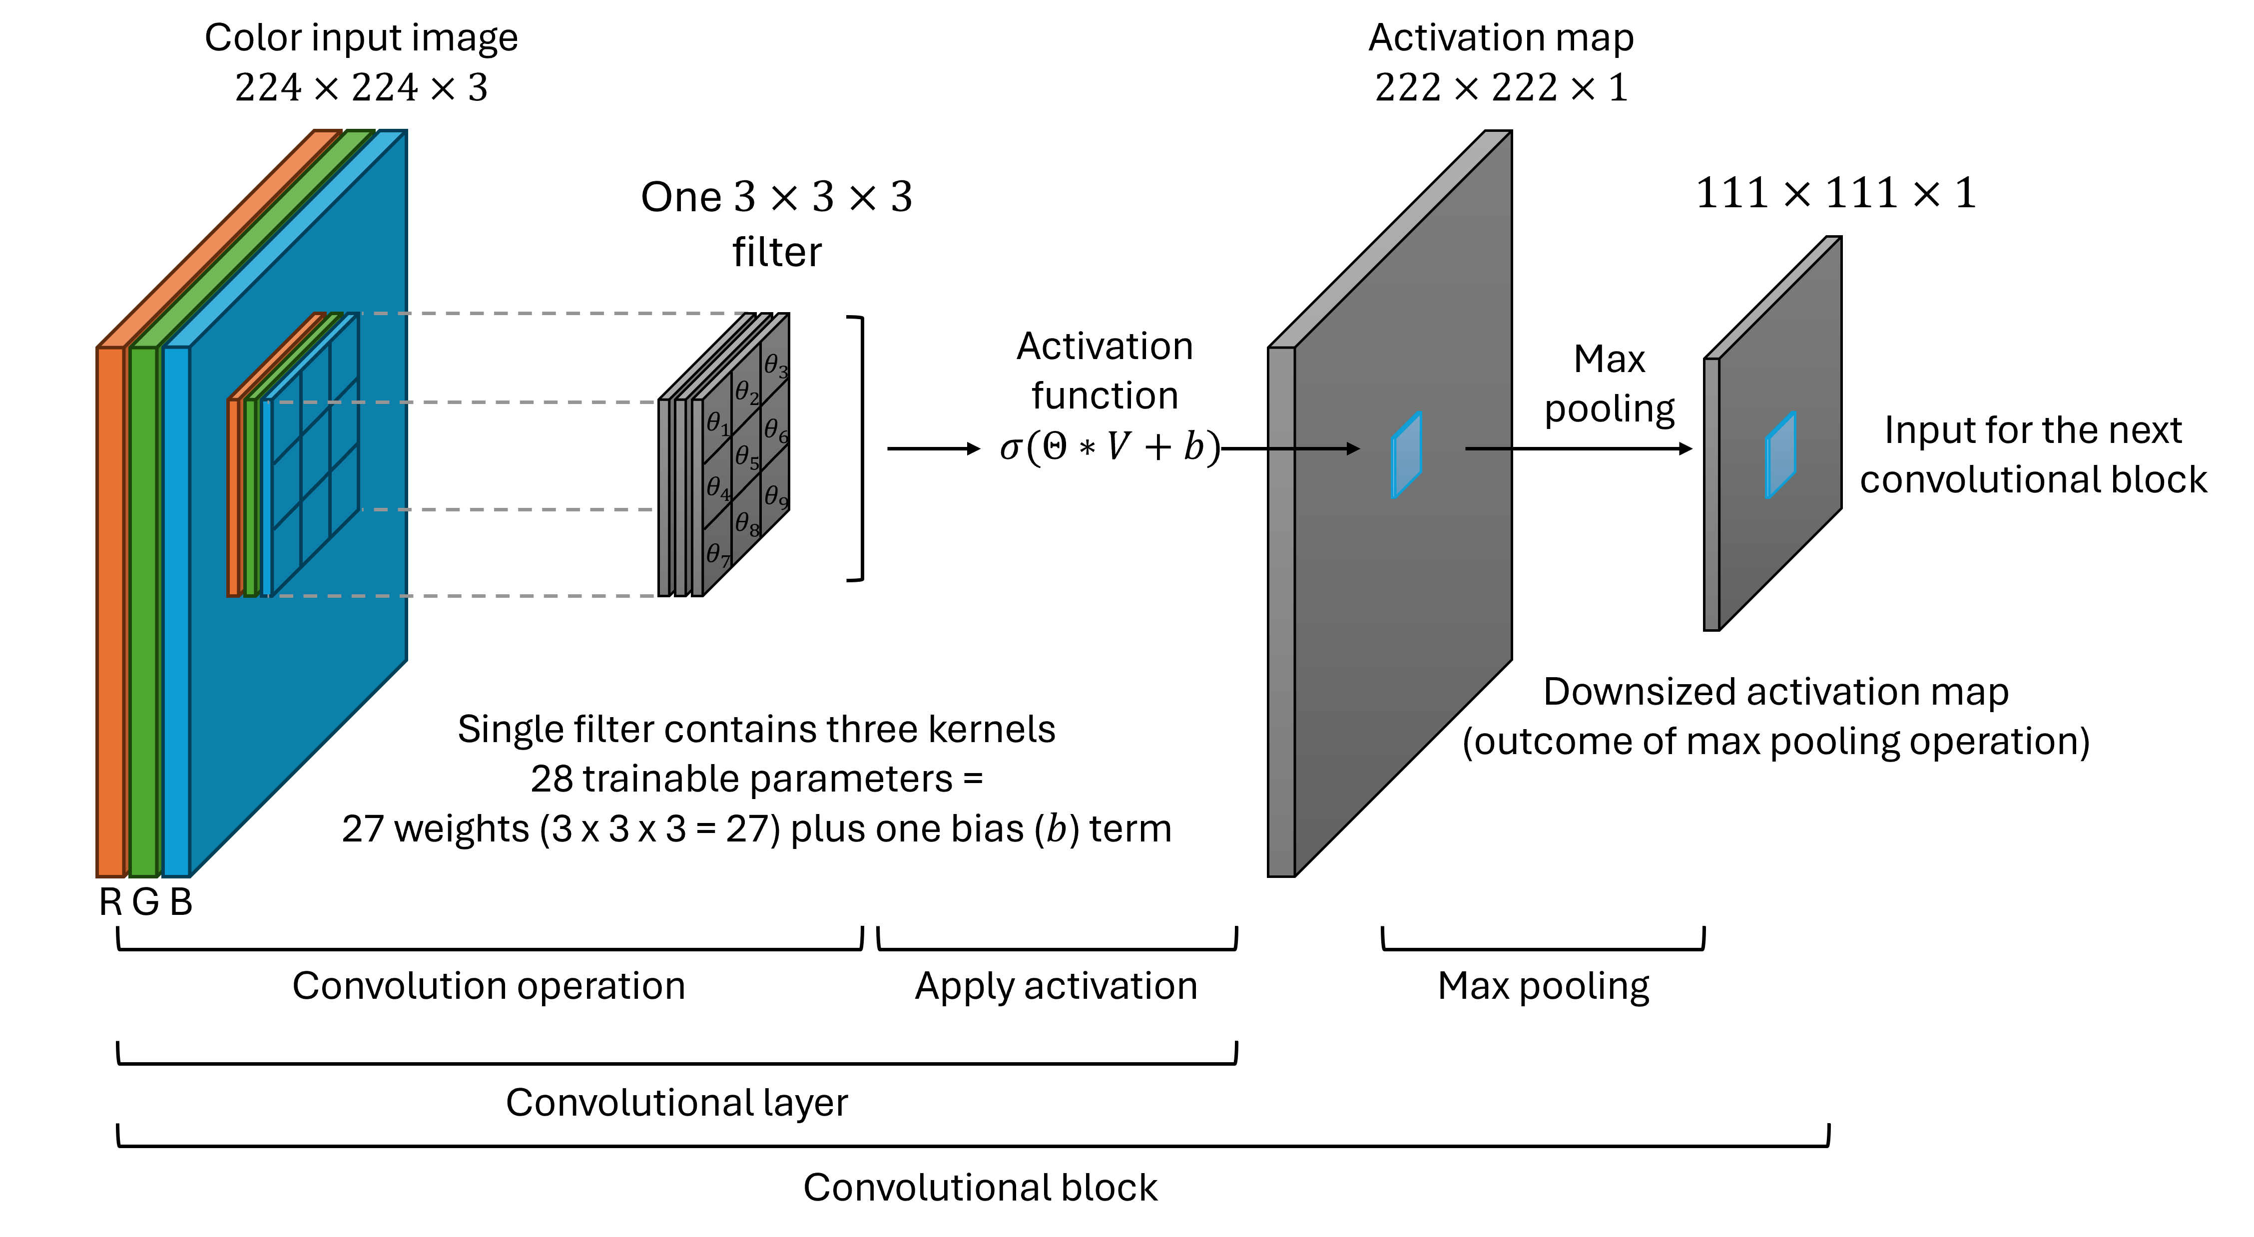
Image modality cnn

Slide 22
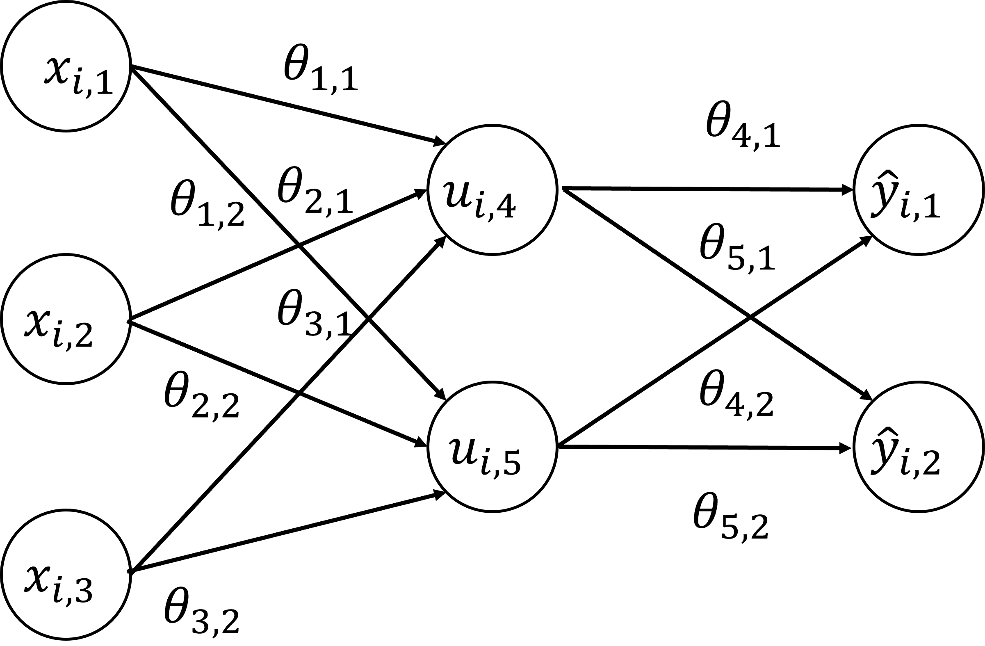
Image modalidty
Encoder decoder model

Slide 23
Image + depth modality
RGB-D Camera

Slide 24
FTIR modality
RAMAN?

Slide 25
3-D computer vision modality

Slide 26
Molecular structure modality
Voxel + Point cloud with mesh texture

Slide 27
Graph modality

Slide 28
Graph modality

Slide 29
Time series modality (sensor)

Slide 30
Time series modality (voice)

Slide 31
Time series modality (text)

Slide 32
Biology modality - primary

Slide 33
Biology modality - secondary

Slide 34
Biology modality - tertiary

Slide 35
Biology modality - tertiary

Slide 36
Thank you
Ho-min Park
Tel: +82-10-4731-3162
Email: homin.park@ghent.ac.kr
GitHub: https://github.com/powersimmani

